Slide 1

Dividends
2026
14. Dividend Study
Dr. Hans-Jörg Naumer
Director Global Capital Markets & Thematic Research
January 2026

Slide 2
Overview
Charts Dividend Study
Dividend Payers
Europe (STOXX 600)
North America (S&P 500)
Asia ex Japan (MSCI Asia ex Japan)
Germany (DAX 40)
Spain (MSCI Spain)
Italy (FTSE MIB)
France (CAC 40)
Switzerland (SMI)
Portugal (PSI)
UK (FTSE 100)

Slide 3
Charts Dividend Study
01

Slide 4
Figure 1: What happened to an investment of 100,000 euros or US dollars over a period of 10 years.
STOXX Europe - 600 price index and dividends
S&P 500 - price index and dividends
Share price performance and dividends, cumulative & monthly
Share price performance and dividends, cumulative & monthly
Source: Allianz Global Investors Global Capital Markets & Thematic Research, Past performance is not indicative of future returns

Slide 5
Figure 2: Total return vs. price indices (-20 years)
Performance Analysis: Current Status Compared to 20 Years Ago
Rebased Performance Analysis: Current Status Compared to 20 Years Ago
(Base Value = 100)
Source: LSEG Datastream, Allianz Global Investors Global Capital Markets & Thematic Research. Past performance does not predict future returns.

Slide 6
Figure 3a: Performance contribution of dividends and share prices over the last 40 years in five-year periods (in % p. a.)
MSCI Europe
Source: LSEG Datastream, Allianz Global Investors Global Capital Markets & Thematic Research. Past performance does not predict future returns. Data as of December 2025

Slide 7
Figure 3b: Performance contribution of dividends and share prices over the last 40 years in five-year periods (in % p. a.)
MSCI North America
Source: LSEG Datastream, Allianz Global Investors Global Capital Markets & Thematic Research. Past performance does not predict future returns. Data as of December 2025

Slide 8
Figure 3c: Performance contribution of dividends and share prices over the last 40 years in five-year periods (in % p. a.)
MSCI Asia ex. Japan
Source: LSEG Datastream, Allianz Global Investors Global Capital Markets & Thematic Research. Past performance does not predict future returns. Data as of December 2025

Slide 9
Figure 3d: Share of p.a. total performance of dividends and price gains over the last 40 years in an international comparison (annualized).
21.26%
39.23%
49.20%
Source: LSEG Datastream, Allianz Global Investors Global Capital Markets & Thematic Research. Past performance does not predict future returns. Data as of December 2025

Slide 10
Figure 4a: Dividend yield over time
STOXX Europe 600
Source: LSEG Datastream, Allianz Global Investors Global Capital Markets & Thematic Research. Past performance does not predict future returns. Data as of December 2025

Slide 11
Figure 4b: Dividend yield over time
S&P 500
Source: LSEG Datastream, Allianz Global Investors Global Capital Markets & Thematic Research. Past performance does not predict future returns. Data as of December 2025

Slide 12
Figure 4c: Dividend yield over time
Asia ex. Japan
Source: LSEG Datastream, Allianz Global Investors Global Capital Markets & Thematic Research. Past performance does not predict future returns. Data as of December 2025

Slide 13
Figure 5a: Number of companies with dividend increases and decreases in the years 2005-2025
STOXX Europe 600
Source: LSEG Datastream, Allianz Global Investors Global Capital Markets & Thematic Research. Past performance does not predict future returns. Data as of December 2025

Slide 14
Figure 5b: Number of companies with dividend increases and decreases in the years 2005-2025
S&P 500
Source: LSEG Datastream, Allianz Global Investors Global Capital Markets & Thematic Research. Past performance does not predict future returns. Data as of December 2025

Slide 15
Figure 5c: Number of companies with dividend increases and decreases in the years 2005-2025
LSEG Asia ex. Japan
Source: LSEG Datastream, Allianz Global Investors Global Capital Markets & Thematic Research. Past performance does not predict future returns. Data as of December 2025

Slide 16
Figure 6a: STOXX 600 Europe
Volatility of the STOXX 600 Europe and its companies with the 25% highest & lowest payout ratios (2005–2025)
Source: LSEG Datastream, Allianz Global Investors Global Capital Markets & Thematic Research. Data as of December 2025

Slide 17
Figure 6b: S&P 500
Volatility of the S&P 500 and its companies with the 25% highest & lowest payout ratios (2005–2025)
Source: LSEG Datastream, Allianz Global Investors Global Capital Markets & Thematic Research. Data as of December 2025

Slide 18
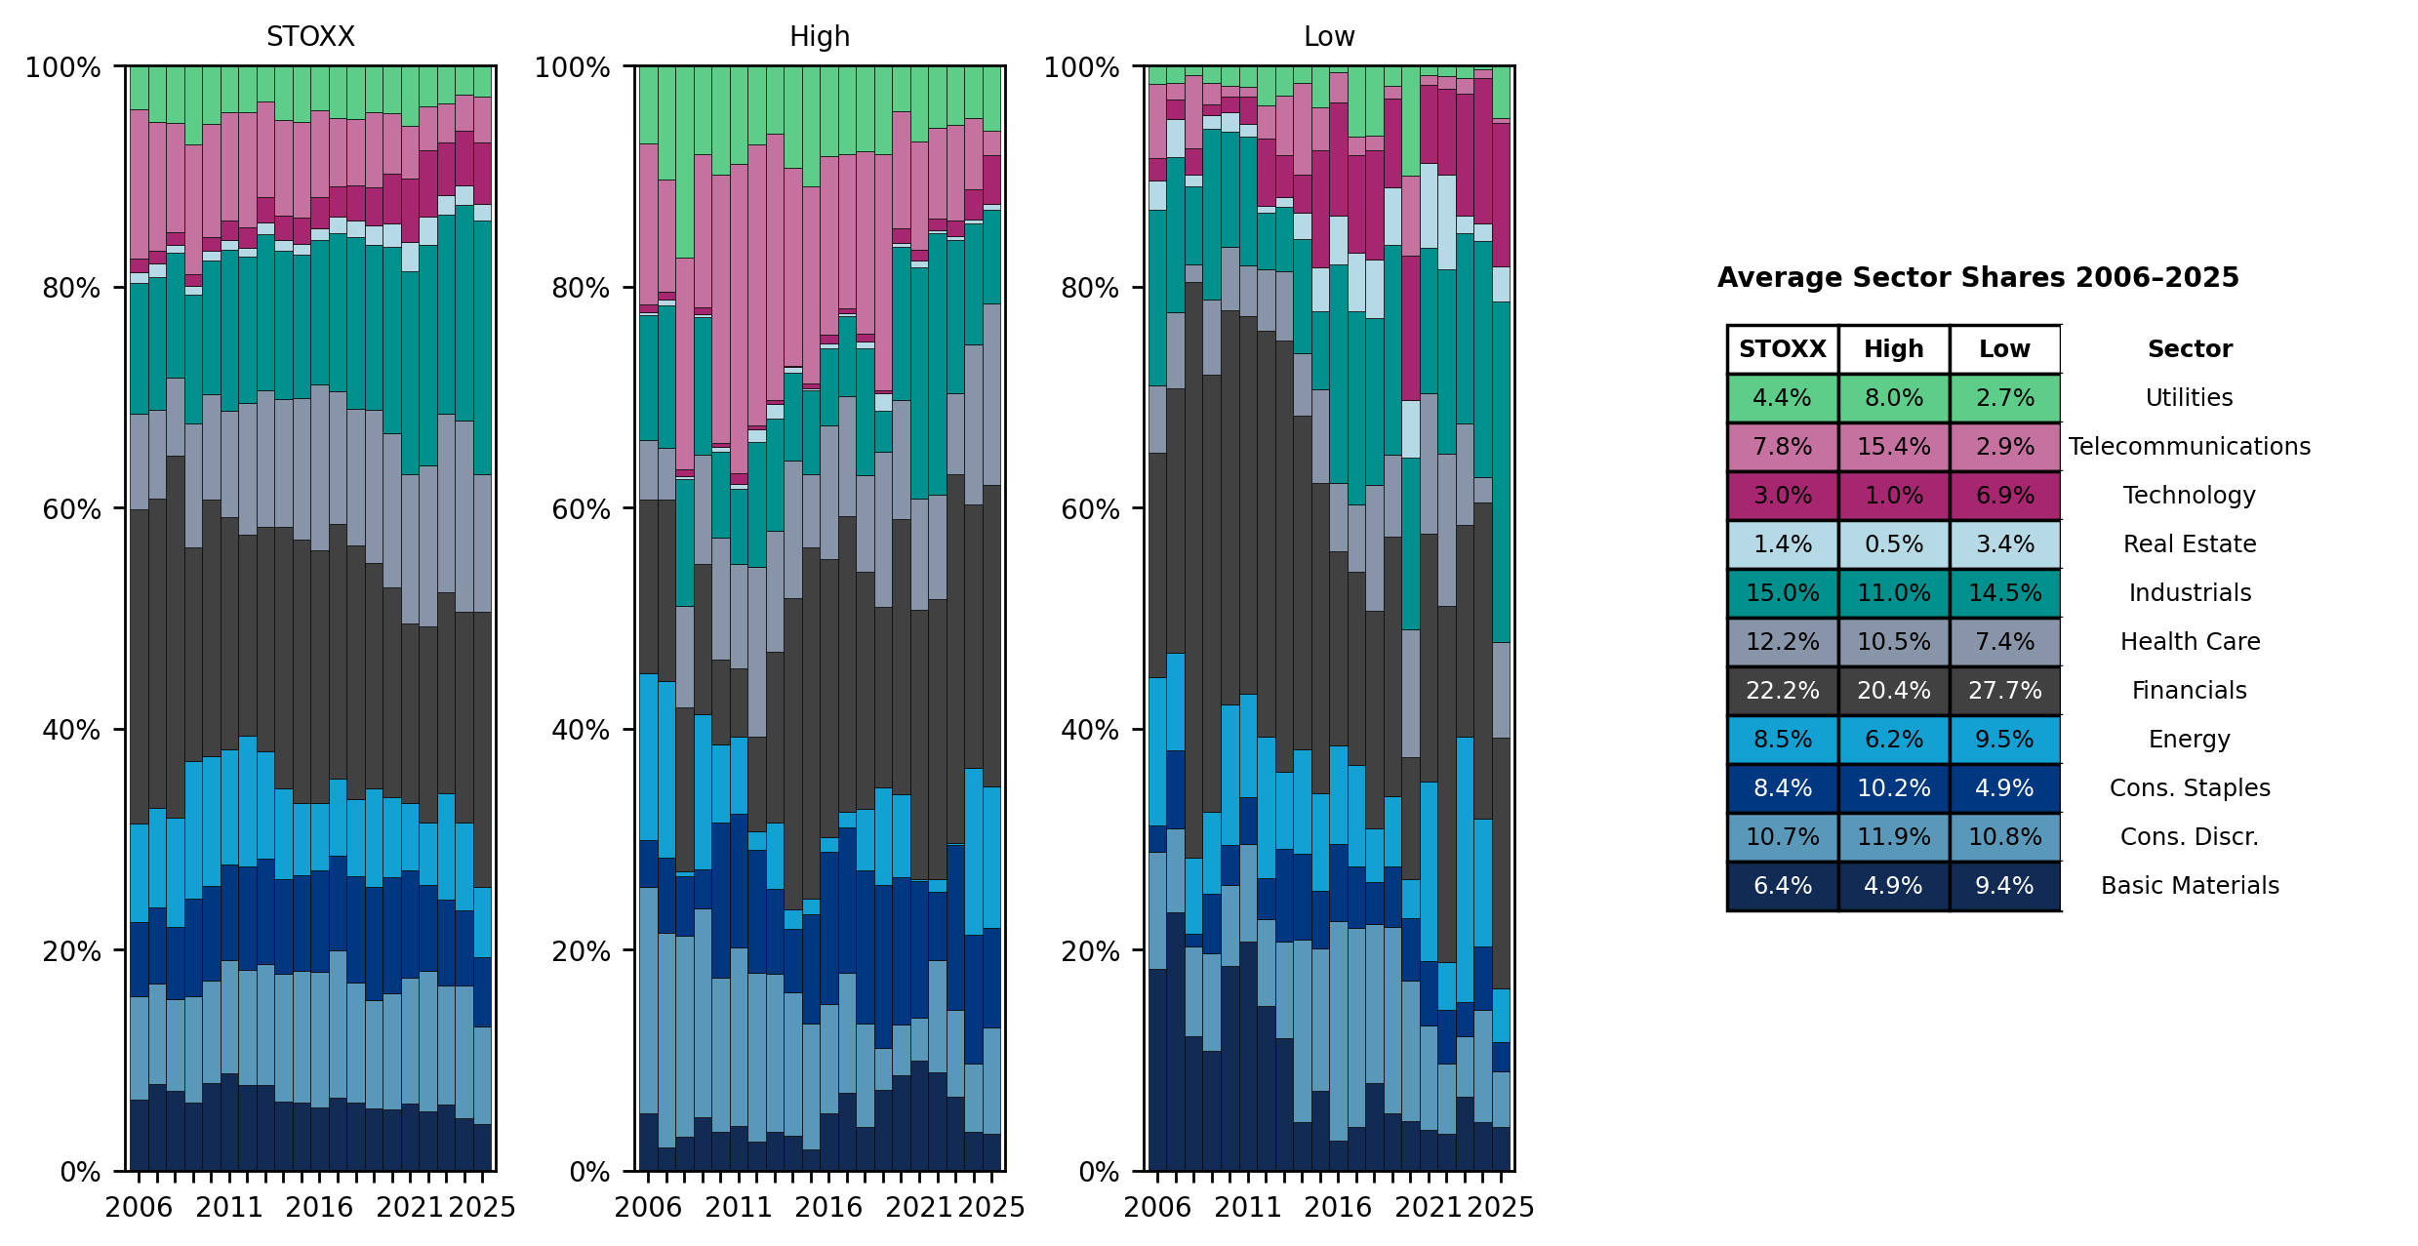
Figure 7a: STOXX 600 Europe – Sector distribution by market capitalization
Source: LSEG Datastream, Allianz Global Investors Global Capital Markets & Thematic Research. Data as of 10/2025

Slide 19
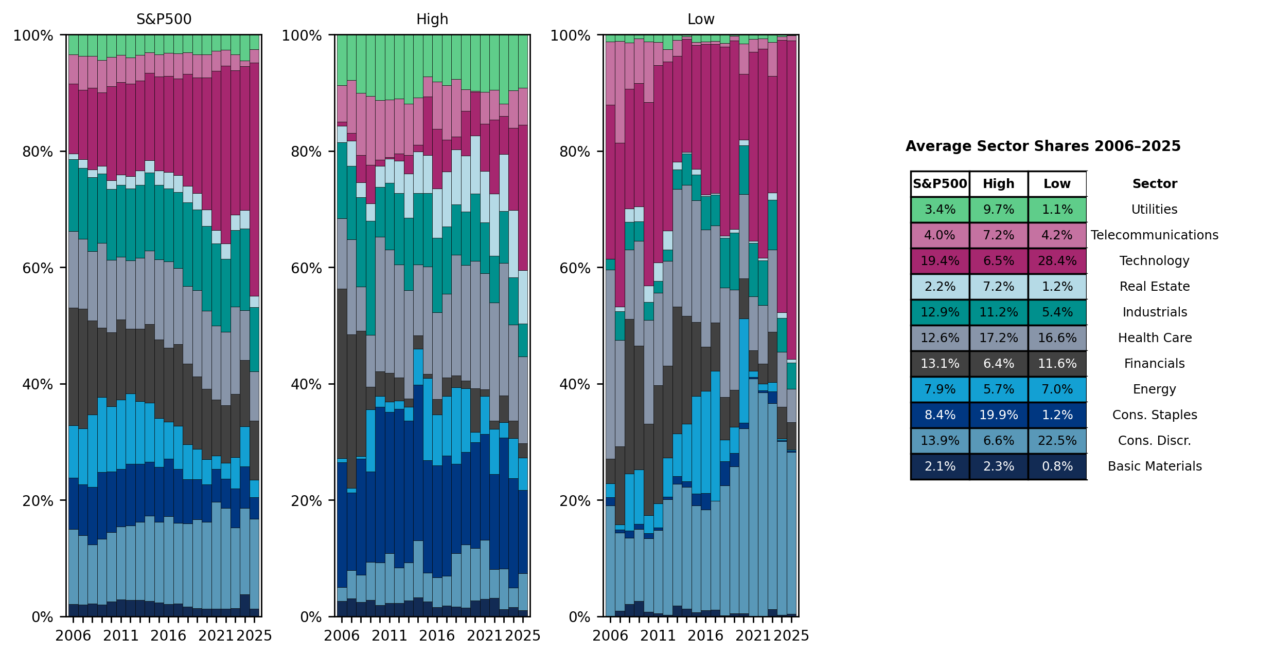
Figure 7b: S&P 500 – Sector distribution by market capitalization
Source: LSEG Datastream, Allianz Global Investors Global Capital Markets & Thematic Research. Data as of 10/2025

Slide 20
Figure 8 "Prosperity for all" is possible - even with small contributions
Example of a savings plan on the MSCI Europe and Stoxx 600, 50 euro/month
Deposited
Last 10 years
6,000 €
Last 20 years
12,000 €
Last 30 years
18,000 €
Last 40 years
24,000 €
Assumptions: reinvestment of dividends, dividends tax-free, withdrawal on retirement, unemployed persons without savings contributions. Due to the insufficient history of the Stoxx 600, a switch was made to the MSCI Europe for the 30 and 40-year periods.
Source: AllianzGI Global Capital Markets & Thematic Research; Past Performance does not predict future returns. As of: December 2025
Notes:
O:\GCMTR\Publikationen\Zukunftsorientierte Themen\Maschinenzeitalter\Maschinenzeitalter\Aktiensparmodelle_WohlstandfürAlle

Slide 21
Dividendpayers
02

Slide 22
Figure 2a: Proportion of Dividend payers in the years 2005-2025
Source: LSEG Datastream, Allianz Global Investors Global Capital Markets & Thematic Research. Past performance does not predict future returns. Data as of December 2025

Slide 23
Figure 2b: Proportion of Dividend payers in the years 2005-2025
Source: LSEG Datastream, Allianz Global Investors Global Capital Markets & Thematic Research. Past performance does not predict future returns. Data as of December 2025

Slide 24
Europe
STOXX 600
03

Slide 25
Dividend yield over time
STOXX Europe 600
Source: LSEG Datastream, Allianz Global Investors Global Capital Markets & Thematic Research. Past performance does not predict future returns. Data as of December 2025

Slide 26
Number of companies which pay dividends in the years 2005-2025
STOXX Europe 600
Source: LSEG Datastream, Allianz Global Investors Global Capital Markets & Thematic Research. Past performance does not predict future returns. Data as of December 2025

Slide 27
Number of companies with dividend increases and decreases in the years 2005-2025
STOXX Europe 600
Source: LSEG Datastream, Allianz Global Investors Global Capital Markets & Thematic Research. Past performance does not predict future returns. Data as of December 2025

Slide 28
Dividend yield per sector in the years 2024 and 2025
STOXX Europe 600
Source: LSEG Datastream, Allianz Global Investors Global Capital Markets & Thematic Research. Past performance does not predict future returns. Data as of December 2025

Slide 29
Number of dividend payers and non-payers by sector in the years 2024 and 2025
STOXX Europe 600
Source: LSEG Datastream, Allianz Global Investors Global Capital Markets & Thematic Research. Past performance does not predict future returns. Data as of December 2025

Slide 30
Top 5 companies with highest 5 years average dividend yield and total dividends paid
STOXX Europe 600
STOXX Europe 600
Dividend yield (5 yrs. avg., in %)
Total dividends paid (5 yrs. avg., in mn. EUR)
Source: LSEG Datastream, Allianz Global Investors Global Capital Markets & Thematic Research. Past performance does not predict future returns. Data as of December 2025

Slide 31
North America
S&P 500
04

Slide 32
Dividend yield over time
S&P 500
Source: LSEG Datastream, Allianz Global Investors Global Capital Markets & Thematic Research. Past performance does not predict future returns. Data as of December 2025

Slide 33
Number of companies which pay dividends in the years 2005-2025
S&P 500
Source: LSEG Datastream, Allianz Global Investors Global Capital Markets & Thematic Research. Past performance does not predict future returns. Data as of December 2025

Slide 34
Number of companies with dividend increases and decreases in the years 2005-2025
S&P 500
Source: LSEG Datastream, Allianz Global Investors Global Capital Markets & Thematic Research. Past performance does not predict future returns. Data as of December 2025

Slide 35
Dividend yield per sector in the years 2024 and 2025
S&P 500
Source: LSEG Datastream, Allianz Global Investors Global Capital Markets & Thematic Research. Past performance does not predict future returns. Data as of December 2025

Slide 36
Number of dividend payers and non-payers by sector in the years 2024 and 2025
S&P 500
Source: LSEG Datastream, Allianz Global Investors Global Capital Markets & Thematic Research. Past performance does not predict future returns. Data as of December 2025

Slide 37
Top 5 companies with highest 5 years average dividend yield and total dividends paid
S&P 500
S&P 500
Dividend yield (5 yrs. avg., in %)
Total dividends paid (5 yrs. avg., in mn. EUR)
Source: LSEG Datastream, Allianz Global Investors Global Capital Markets & Thematic Research. Past performance does not predict future returns. Data as of December 2025

Slide 38
Asia ex. Japan
LSEG Asia ex. Japan
05

Slide 39
Dividend yield over time
LSEG Asia ex. Japan
Source: LSEG Datastream, Allianz Global Investors Global Capital Markets & Thematic Research. Past performance does not predict future returns. Data as of December 2025

Slide 40
Number of companies which pay dividends in the years 2005-2025
LSEG Asia ex. Japan
Source: LSEG Datastream, Allianz Global Investors Global Capital Markets & Thematic Research. Past performance does not predict future returns. Data as of December 2025

Slide 41
Number of companies with dividend increases and decreases in the years 2005-2025
LSEG Asia ex. Japan
Source: LSEG Datastream, Allianz Global Investors Global Capital Markets & Thematic Research. Past performance does not predict future returns. Data as of December 2025

Slide 42
Dividend yield per sector in the years 2024 and 2025
LSEG Asia ex. Japan
Source: LSEG Datastream, Allianz Global Investors Global Capital Markets & Thematic Research. Past performance does not predict future returns. Data as of December 2025

Slide 43
Number of dividend payers and non-payers by sector in the years 2024 and 2025
LSEG Asia ex. Japan
Source: LSEG Datastream, Allianz Global Investors Global Capital Markets & Thematic Research. Past performance does not predict future returns. Data as of December 2025

Slide 44
Germany
DAX 40
06

Slide 45
Number of companies which pay dividends in the years 2005-2025
DAX 40
Source: LSEG Datastream, Allianz Global Investors Global Capital Markets & Thematic Research. Past performance does not predict future returns. Data as of December 2025

Slide 46
Number of companies with dividend increases and decreases in the years 2005-2025
DAX 40
Source: LSEG Datastream, Allianz Global Investors Global Capital Markets & Thematic Research. Past performance does not predict future returns. Data as of December 2025

Slide 47
Dividend yield per sector in the years 2024 and 2025
DAX 40
Source: LSEG Datastream, Allianz Global Investors Global Capital Markets & Thematic Research. Past performance does not predict future returns. Data as of December 2025

Slide 48
Number of dividend payers and non-payers by sector in the years 2024 and 2025
DAX 40
Source: LSEG Datastream, Allianz Global Investors Global Capital Markets & Thematic Research. Past performance does not predict future returns. Data as of December 2025

Slide 49
Top 5 companies with highest 5 years average dividend yield and total dividends paid
DAX 40
DAX 40
Dividend yield (5 yrs. avg., in %)
Total dividends paid (5 yrs. avg., in mn. EUR)
Source: LSEG Datastream, Allianz Global Investors Global Capital Markets & Thematic Research. Past performance does not predict future returns. Data as of December 2025

Slide 50
Spain
MSCI Spain
07

Slide 51
Number of companies which pay dividends in the years 2008-2025
MSCI Spain
Source: LSEG Datastream, Allianz Global Investors Global Capital Markets & Thematic Research. Past performance does not predict future returns. Data as of December 2025

Slide 52
Number of companies with dividend increases and decreases in the years 2008-2025
MSCI Spain
Source: LSEG Datastream, Allianz Global Investors Global Capital Markets & Thematic Research. Past performance does not predict future returns. Data as of December 2025

Slide 53
Dividend yield per sector in the years 2024 and 2025
MSCI Spain
Source: LSEG Datastream, Allianz Global Investors Global Capital Markets & Thematic Research. Past performance does not predict future returns. Data as of December 2025

Slide 54
Number of dividend payers and non-payers by sector in the years 2024 and 2025
MSCI Spain
Source: LSEG Datastream, Allianz Global Investors Global Capital Markets & Thematic Research. Past performance does not predict future returns. Data as of December 2025

Slide 55
Top 5 companies with highest 5 years average dividend yield and total dividends paid
MSCI Spain
MSCI Spain
Dividend yield (5 yrs. avg., in %)
Total dividends paid (5 yrs. avg., in mn. EUR)
Source: LSEG Datastream, Allianz Global Investors Global Capital Markets & Thematic Research. Past performance does not predict future returns. Data as of December 2025

Slide 56
Italy
MSCI Italy
08

Slide 57
Number of companies which pay dividends in the years 2005-2025
MSCI Italy
Source: LSEG Datastream, Allianz Global Investors Global Capital Markets & Thematic Research. Past performance does not predict future returns. Data as of December 2025

Slide 58
Number of companies with dividend increases and decreases in the years 2005-2025
MSCI Italy
Source: LSEG Datastream, Allianz Global Investors Global Capital Markets & Thematic Research. Past performance does not predict future returns. Data as of December 2025

Slide 59
Top 5 companies with highest 5 years average dividend yield and total dividends paid
MSCI MIB
MSCI MIB
Dividend yield (5 yrs. avg., in %)
Total dividends paid (5 yrs. avg., in mn. EUR)
Source: LSEG Datastream, Allianz Global Investors Global Capital Markets & Thematic Research. Past performance does not predict future returns. Data as of December 2025

Slide 60
France
CAC 40
09

Slide 61
Number of companies which pay dividends in the years 2005-2025
CAC 40
Source: LSEG Datastream, Allianz Global Investors Global Capital Markets & Thematic Research. Past performance does not predict future returns. Data as of December 2025

Slide 62
Number of companies with dividend increases and decreases in the years 2005-2025
CAC 40
Source: LSEG Datastream, Allianz Global Investors Global Capital Markets & Thematic Research. Past performance does not predict future returns. Data as of December 2025

Slide 63
Dividend yield per sector in the years 2024 and 2025
CAC 40
Source: LSEG Datastream, Allianz Global Investors Global Capital Markets & Thematic Research. Past performance does not predict future returns. Data as of December 2025

Slide 64
Number of dividend payers and non-payers by sector in the years 2024 and 2025
CAC 40
Source: LSEG Datastream, Allianz Global Investors Global Capital Markets & Thematic Research. Past performance does not predict future returns. Data as of December 2025

Slide 65
Top 5 companies with highest 5 years average dividend yield and total dividends paid
CAC 40
CAC 40
Dividend yield (5 yrs. avg., in %)
Total dividends paid (5 yrs. avg., in mn. EUR)
Source: LSEG Datastream, Allianz Global Investors Global Capital Markets & Thematic Research. Past performance does not predict future returns. Data as of December 2025

Slide 66
Switzerland
SMI
10

Slide 67
Number of companies which pay dividends in the years 2005-2025
SMI
Source: LSEG Datastream, Allianz Global Investors Global Capital Markets & Thematic Research. Past performance does not predict future returns. Data as of December 2025

Slide 68
Number of companies with dividend increases and decreases in the years 2005-2025
SMI
Source: LSEG Datastream, Allianz Global Investors Global Capital Markets & Thematic Research. Past performance does not predict future returns. Data as of December 2025

Slide 69
Dividend yield per sector in the years 2024 and 2025
SMI
Source: LSEG Datastream, Allianz Global Investors Global Capital Markets & Thematic Research. Past performance does not predict future returns. Data as of December 2025

Slide 70
Number of dividend payers and non-payers by sector in the years 2024 and 2025
SMI
Source: LSEG Datastream, Allianz Global Investors Global Capital Markets & Thematic Research. Past performance does not predict future returns. Data as of December 2025

Slide 71
Top 5 companies with highest 5 years average dividend yield and total dividends paid
SMI
SMI
Dividend yield (5 yrs. avg., in %)
Total dividends paid (5 yrs. avg., in mn. EUR)
Source: LSEG Datastream, Allianz Global Investors Global Capital Markets & Thematic Research. Past performance does not predict future returns. Data as of December 2025

Slide 72
Portugal
PSI
11

Slide 73
Number of companies which pay dividends in the years 2007-2025
PSI
Source: LSEG Datastream, Allianz Global Investors Global Capital Markets & Thematic Research. Past performance does not predict future returns. Data as of December 2025

Slide 74
Number of companies with dividend increases and decreases in the years 2007-2025
PSI
Source: LSEG Datastream, Allianz Global Investors Global Capital Markets & Thematic Research. Past performance does not predict future returns. Data as of December 2025

Slide 75
Dividend yield per sector in the years 2024 and 2025
PSI
Source: LSEG Datastream, Allianz Global Investors Global Capital Markets & Thematic Research. Past performance does not predict future returns. Data as of December 2025

Slide 76
Number of dividend payers and non-payers by sector in the years 2024 and 2025
PSI
Source: LSEG Datastream, Allianz Global Investors Global Capital Markets & Thematic Research. Past performance does not predict future returns. Data as of December 2025

Slide 77
Top 5 companies with highest 5 years average dividend yield and total dividends paid
PSI
PSI
Dividend yield (5 yrs. avg., in %)
Total dividends paid (5 yrs. avg., in mn. EUR)
Source: LSEG Datastream, Allianz Global Investors Global Capital Markets & Thematic Research. Past performance does not predict future returns. Data as of December 2025

Slide 78
UK
FTSE 100
12

Slide 79
Number of companies which pay dividends in the years 2005-2025
FTSE 100
Source: LSEG Datastream, Allianz Global Investors Global Capital Markets & Thematic Research. Past performance does not predict future returns. Data as of December 2025

Slide 80
Number of companies with dividend increases and decreases in the years 2005-2025
FTSE 100
Source: LSEG Datastream, Allianz Global Investors Global Capital Markets & Thematic Research. Past performance does not predict future returns. Data as of December 2025

Slide 81
Dividend yield per sector in the years 2024 and 2025
FTSE 100
Source: LSEG Datastream, Allianz Global Investors Global Capital Markets & Thematic Research. Past performance does not predict future returns. Data as of December 2025

Slide 82
Number of dividend payers and non-payers by sector in the years 2024 and 2025
FTSE 100
Source: LSEG Datastream, Allianz Global Investors Global Capital Markets & Thematic Research. Past performance does not predict future returns. Data as of December 2025

Slide 83
Top 5 companies with highest 5 years average dividend yield and total dividends paid
FTSE 100
FTSE 100
Dividend yield (5 yrs. avg., in %)
Total dividends paid (5 yrs. avg., in mn. EUR)
Source: LSEG Datastream, Allianz Global Investors Global Capital Markets & Thematic Research. Past performance does not predict future returns. Data as of December 2025

Slide 85
Disclaimer
Investing involves risk. The value of an investment and the income from it will fluctuate and investors may not get back the principal invested. Equities have tended to be volatile, and do not offer a fixed rate of return. Dividend-paying stocks are not guaranteed to continue to pay dividends. Investing in the bond market is subject to risks, including market, interest rate, issuer, credit, inflation risk, and liquidity risk. The value of most bonds and bond strategies are impacted by changes in interest rates. Bond prices will normally decline as interest rates rise. The impact may be greater with longer-duration bonds. Credit risk reflects the issuer’s ability to make timely payments of interest or principal—the lower the rating, the higher the risk of default.Past performance is not indicative of future performance. This is a marketing communication. It is for informational purposes only. This document does not constitute investment advice or a recommendation to buy, sell or hold any security and shall not be deemed an offer to sell or a solicitation of an offer to buy any security. Foreign markets may be more volatile, less liquid, less transparent, and subject to less oversight, and values may fluctuate with currency exchange rates; these risks may be greater in emerging markets. The views and opinions expressed herein, which are subject to change without notice, are those of the issuer or its affiliated companies at the time of publication. Certain data used are derived from various sources believed to be reliable, but the accuracy or completeness of the data is not guaranteed and no liability is assumed for any direct or consequential losses arising from their use. The duplication, publication, extraction or transmission of the contents, irrespective of the form, is not permitted. This material has not been reviewed by any regulatory authorities. In mainland China, it is used only as supporting material to the offshore investment products offered by commercial banks under the Qualified Domestic Institutional Investors scheme pursuant to applicable rules and regulations. This document does not constitute a public offer by virtue of Act Number 26.831 of the Argentine Republic and General Resolution No. 622/2013 of the NSC. This communication's sole purpose is to inform and does not under any circumstance constitute promotion or publicity of Allianz Global Investors products and/or services in Colombia or to Colombian residents pursuant to part 4 of Decree 2555 of 2010. This communication does not in any way aim to directly or indirectly initiate the purchase of a product or the provision of a service offered by Allianz Global Investors. Via reception of his document, each resident in Colombia acknowledges and accepts to have contacted Allianz Global Investors via their own initiative and that the communication under no circumstances does not arise from any promotional or marketing activities carried out by Allianz Global Investors. Colombian residents accept that accessing any type of social network page of Allianz Global Investors is done under their own responsibility and initiative and are aware that they may access specific information on the products and services of Allianz Global Investors. This communication is strictly private and confidential and may not be reproduced. This communication does not constitute a public offer of securities in Colombia pursuant to the public offer regulation set forth in Decree 2555 of 2010. This communication and the information provided herein should not be considered a solicitation or an offer by Allianz Global Investors or its affiliates to provide any financial products in Brazil, Panama, Peru, and Uruguay. In Australia, this material is presented by Allianz Global Investors Asia Pacific Limited (“AllianzGI AP”) and is intended for the use of investment consultants and other institutional/professional investors only, and is not directed to the public or individual retail investors. AllianzGI AP is not licensed to provide financial services to retail clients in Australia. AllianzGI AP (Australian Registered Body Number 160 464 200) is exempt from the requirement to hold an Australian Foreign Financial Service License under the Corporations Act 2001 (Cth) pursuant to ASIC Class Order (CO 03/1103) with respect to the provision of financial services to wholesale clients only. AllianzGI AP is licensed and regulated by Hong Kong Securities and Futures Commission under Hong Kong laws, which differ from Australian laws. This document is being distributed by the following Allianz Global Investors companies: Allianz Global Investors U.S. LLC, an investment adviser registered with the U.S. Securities and Exchange Commission; Allianz Global Investors Distributors LLC, distributor registered with FINRA, is affiliated with Allianz Global Investors U.S. LLC; Allianz Global Investors GmbH, an investment company in Germany, authorized by the German Bundesanstalt für Finanzdienstleistungsaufsicht (BaFin); Allianz Global Investors (Schweiz) AG; Allianz Global Investors Asia Pacific Ltd., licensed by the Hong Kong Securities and Futures Commission; Allianz Global Investors Singapore Ltd., regulated by the Monetary Authority of Singapore [Company Registration No. 199907169Z]; Allianz Global Investors Japan Co., Ltd., registered in Japan as a Financial Instruments Business Operator [Registered No. The Director of Kanto Local Finance Bureau (Financial Instruments Business Operator), No. 424, Member of Japan Investment Advisers Association and Investment Trust Association, Japan];and Allianz Global Investors Taiwan Ltd., licensed by Financial Supervisory Commission in Taiwan.

